Slide 1

Prajwal Patankar
33244
IT Department
Pune Institute of Computer Technology
SL-3 Assignment [ HTML5 Basic Tags ]

Slide 2
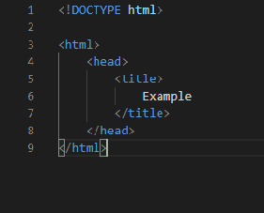
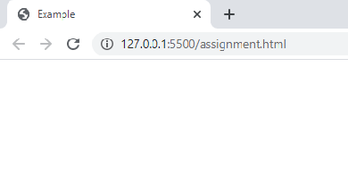
Title
<title>
The title element contains the title of the page, which is displayed in the browser’s title bar on the top.
It is written inside the <head> … </head> tag
Eg:

Slide 3
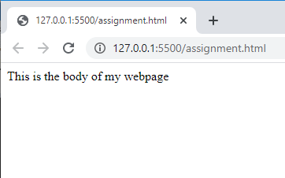
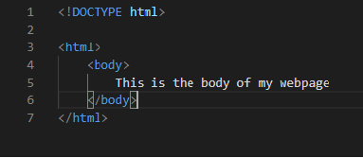
body
<body>
The body tag appears usually after the head element.
It contains all the content of the webpage
Eg:

Slide 4
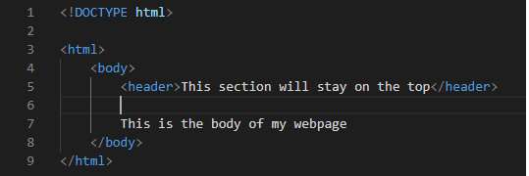
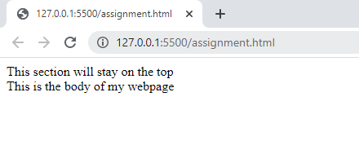
Header
<header>
It defines the header of a page and usually contains logo, search, navigation bar, etc.
Eg:

Slide 5
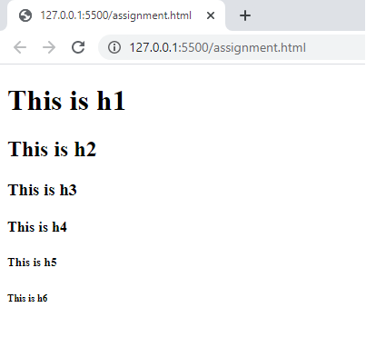
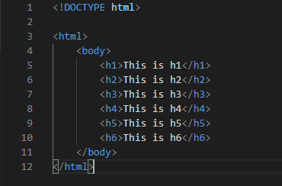
heading
<h1>, <h2>, <h3>, <h4>, <h5>, <h6>, <h7>
Heading tags help us to break up our page into headings, subheadings, etc.
HTML supports 6 heading tags, h1 for most important heading, h2 for less important headings and so on.
Eg:

Slide 6
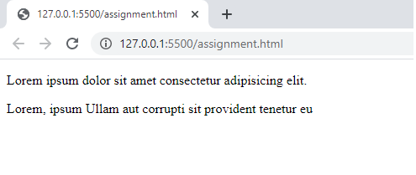
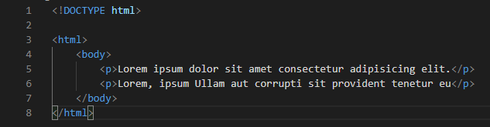
Paragraphs
<p>
It defines a paragraph
It adds a line break after a paragraph, thus separating 2 paragraphs
Eg:

Slide 7
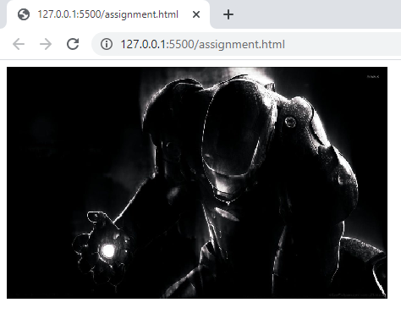
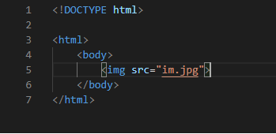
images
<img>
This tag is used to embed an image in HTML
Eg:

Slide 8
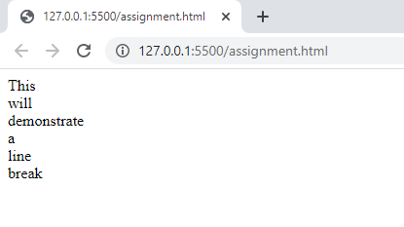
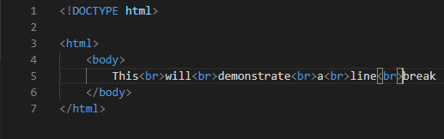
Line break
<br>
This tag is used to insert a line break between 2 lines
Eg:

Slide 9
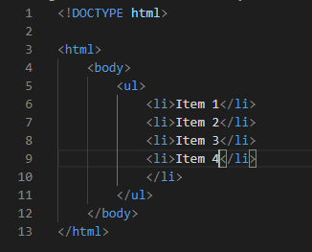
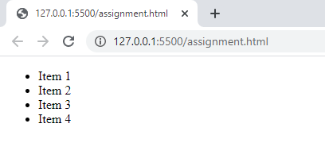
lists
<ul> <li>
They are used to make lists of items.
Eg:

Slide 10
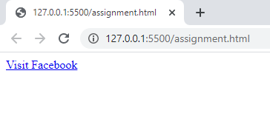
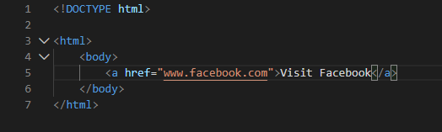
Links
<a>
This tag is used to create hyperlinks, to link one page to another.
Clicking on the link will open the page associated with it.
Eg:

